Slide 1
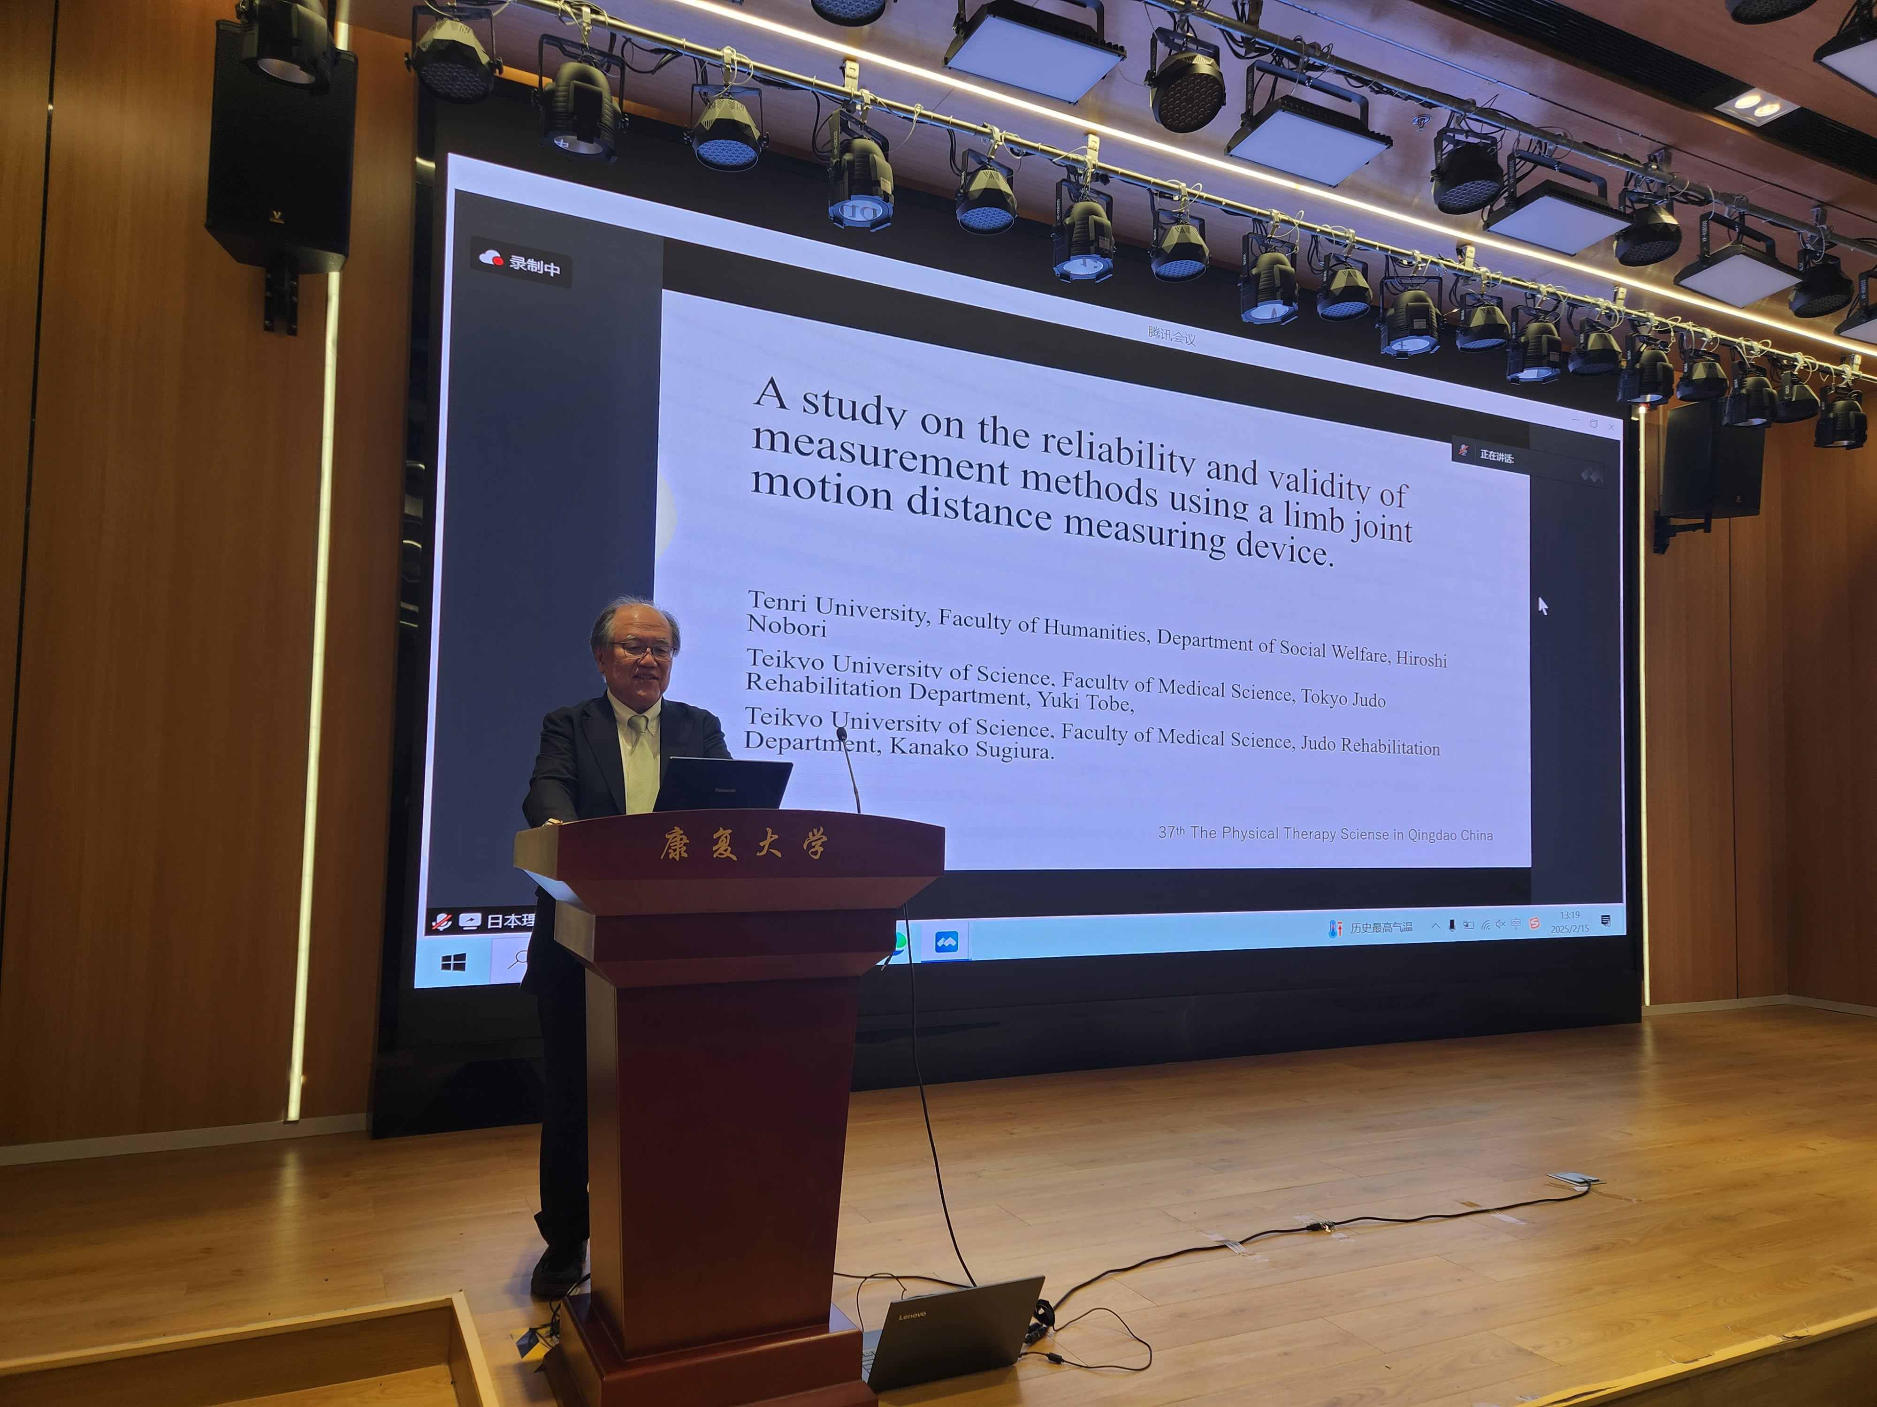

Slide 2
A study on the reliability and validity of measurement methods using a limb joint motion distance measuring device.
Tenri University, Faculty of Humanities, Department of Social Welfare, Hiroshi Nobu,
Teikyo University of Science, Faculty of Medical Science, Tokyo Judo Rehabilitation Department, Yuki Tobe,
Teikyo University of Science, Faculty of Medical Science, Judo Rehabilitation Department, Kanako Sugiura.
37th The Physical Therapy Sciense in Qingdao China

